Slide 1
Object detection in x-ray images
Group Name: Oasis
Group members:
Nattapat Juthaprachakul, Rui Wang, Siyu Wu, Yihan Lan

Slide 2
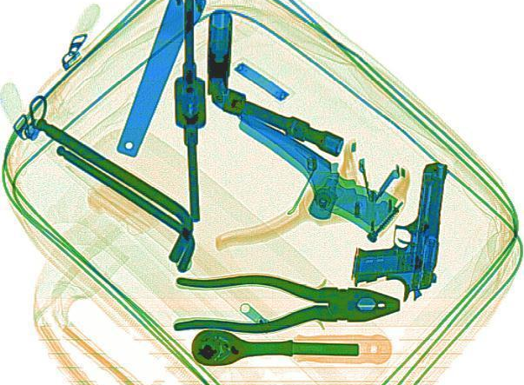
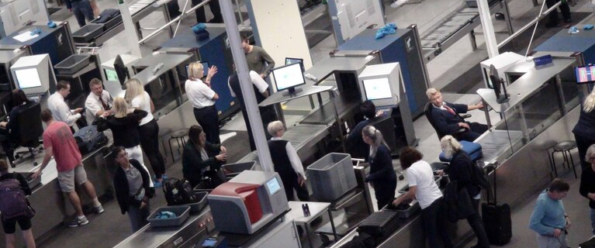
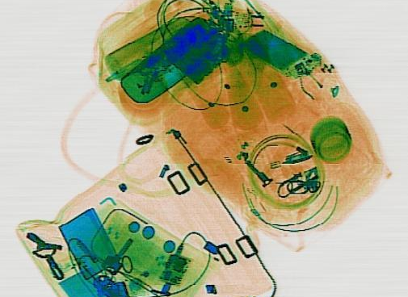
Motivation: Importance of this project

Slide 3
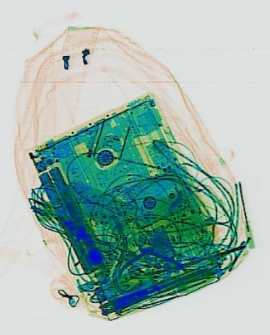
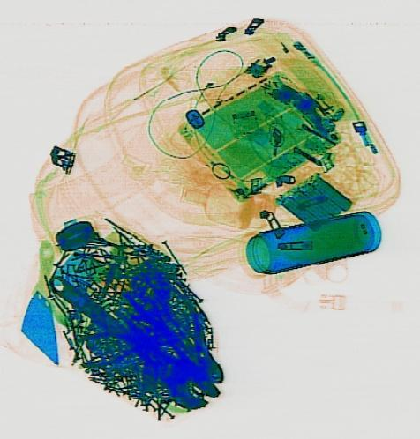
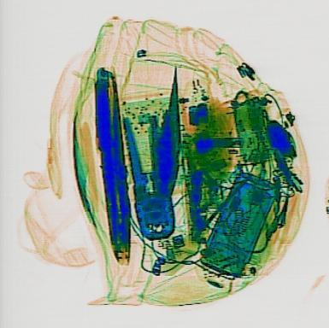
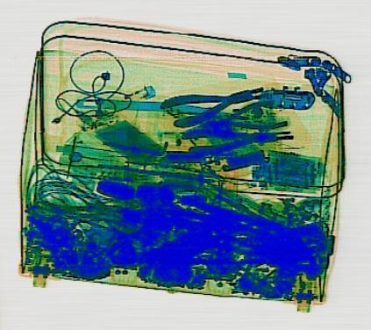
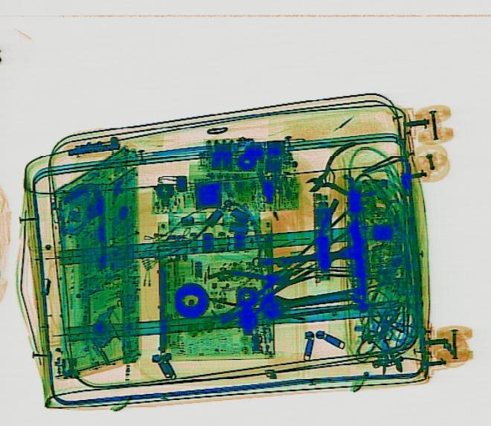
Challenges

Slide 4
Schedule
Obtain dataset (Sixray dataset)
Pre-process image information like location and class of objects in image
Create training pipeline for model training on cloud
Train Object detection model and see the results with subset of dataset
Train different Object detection models with subset of dataset
Evaluate each model in various metrics such as accuracy and recall score, time performance, etc.
Train model with full dataset (and may add new dataset into)
Repeat step 6 with our new models
Report, Poster, Video, Presentation

Slide 5
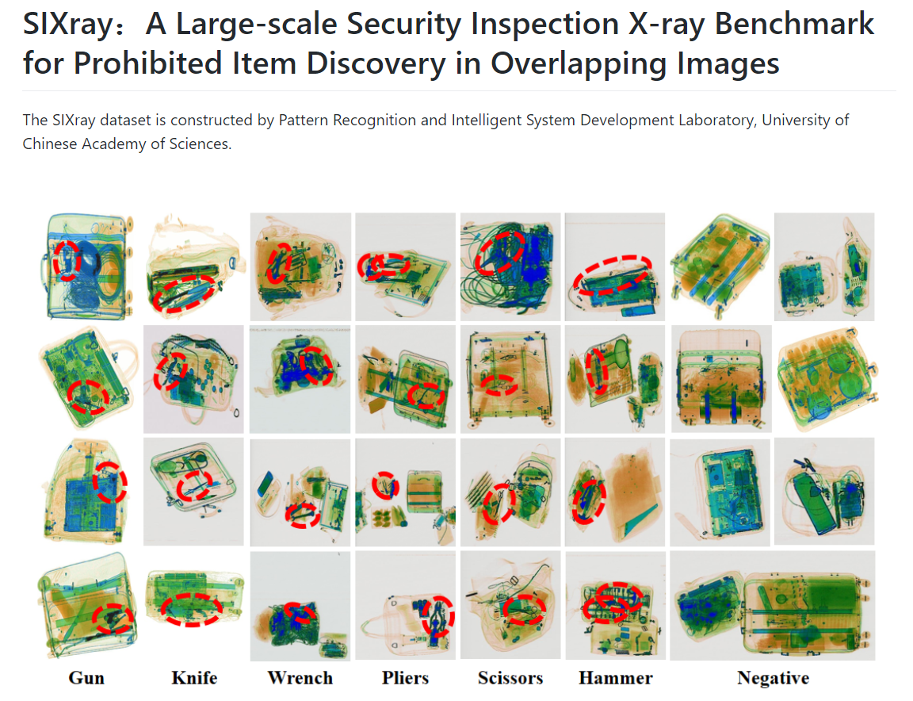
Schedule
Obtain dataset (Sixray dataset)

Slide 6
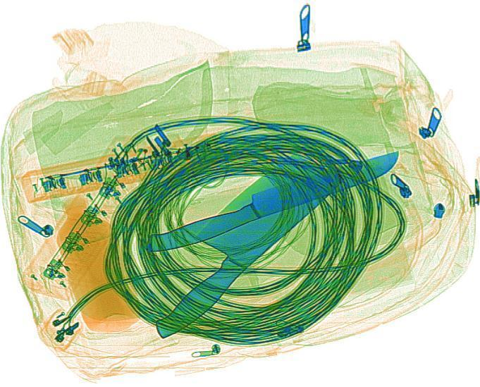
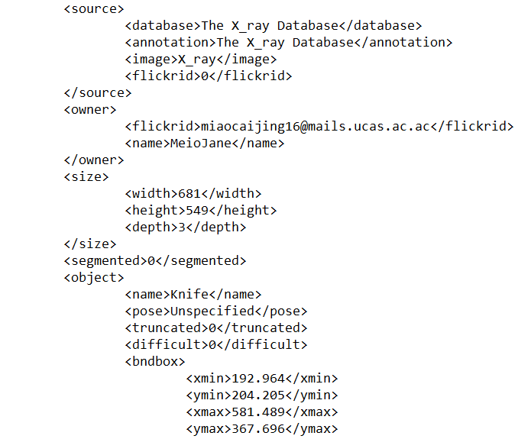
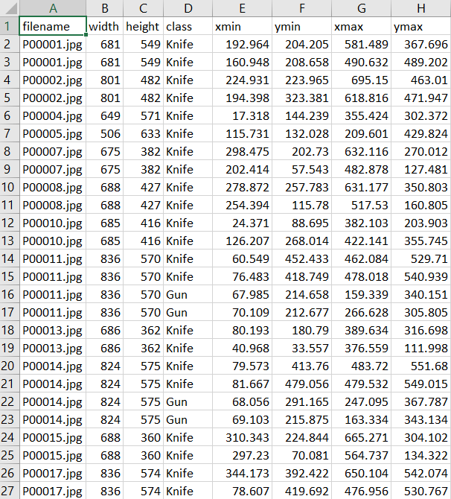
Schedule
Pre-process image information:
Create readable data format by combining real image with image meta data such as class and location of the objects

Slide 7
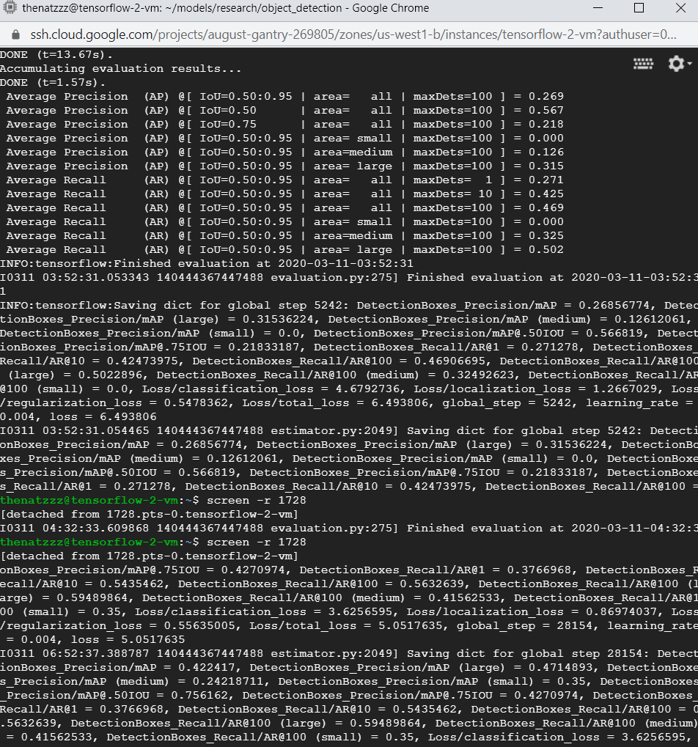
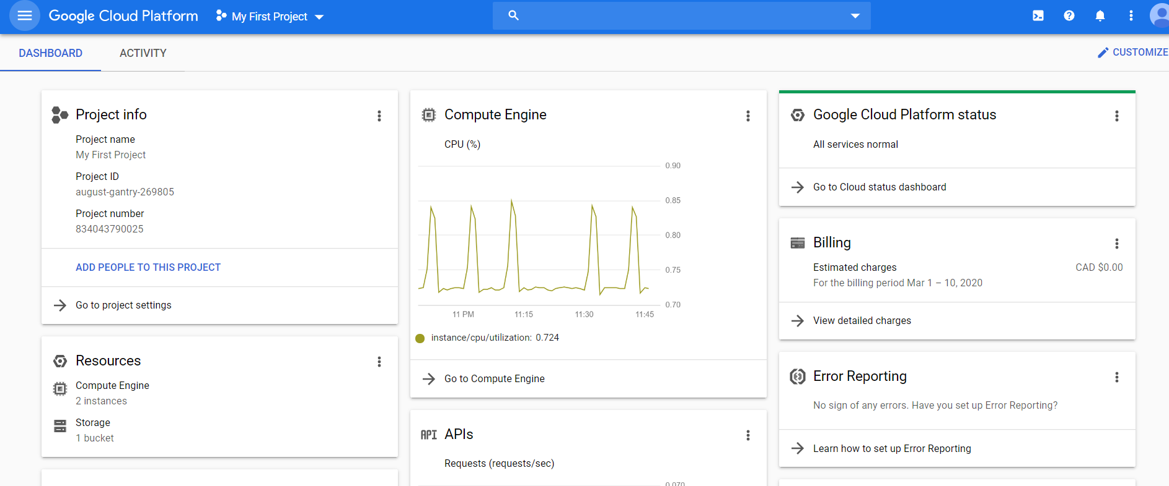
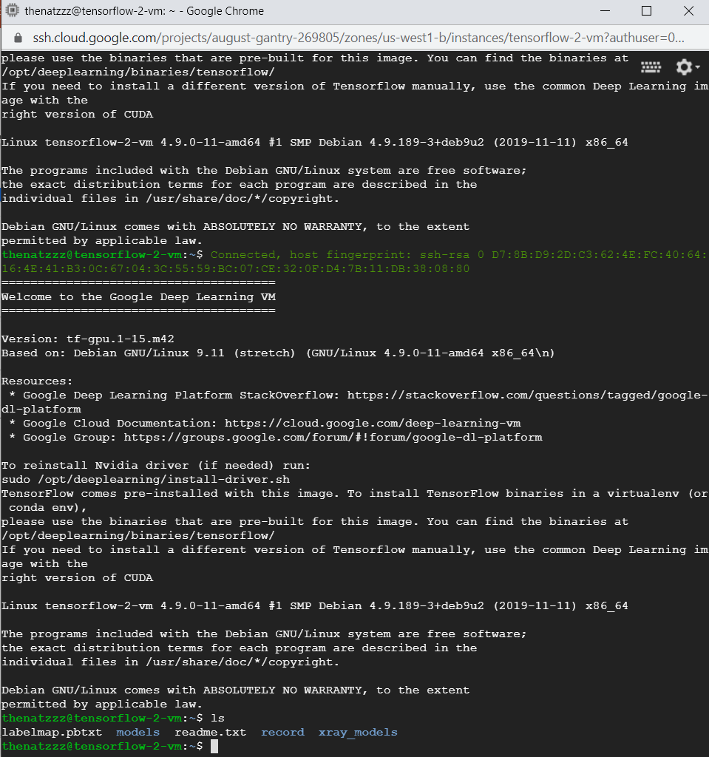
Schedule
3. Create training pipeline for model training on cloud

Slide 8
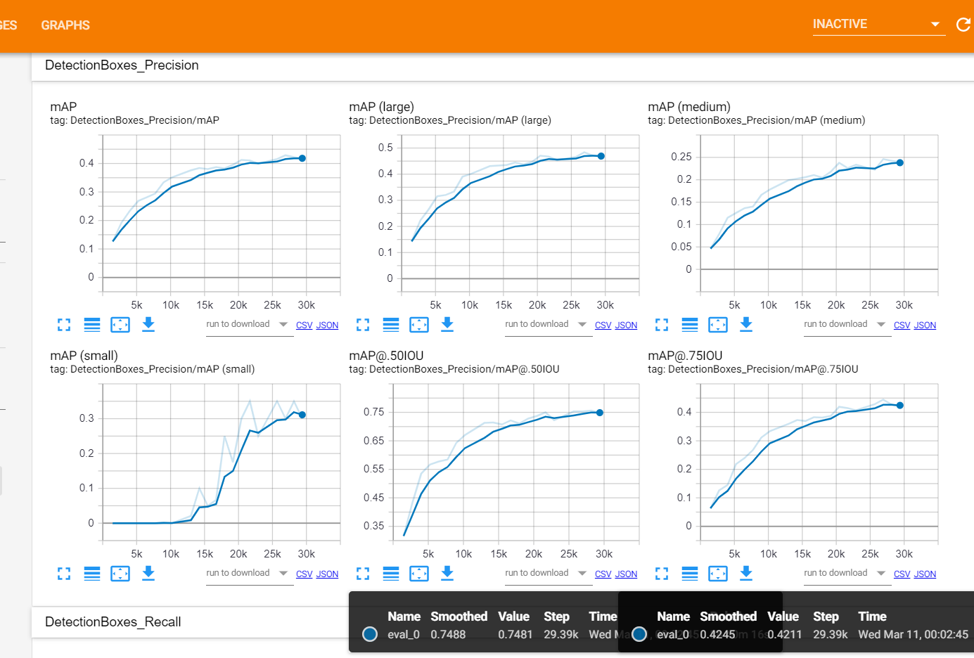
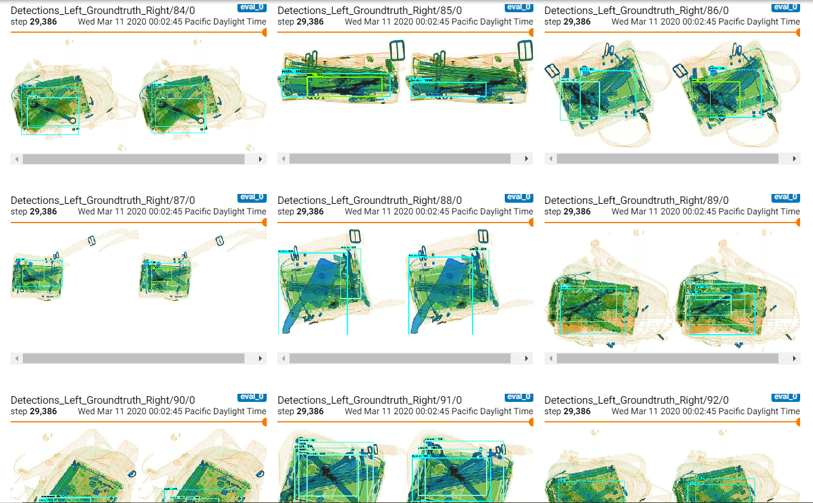
Schedule
Train Object detection model and see the results with subset of dataset

Slide 9
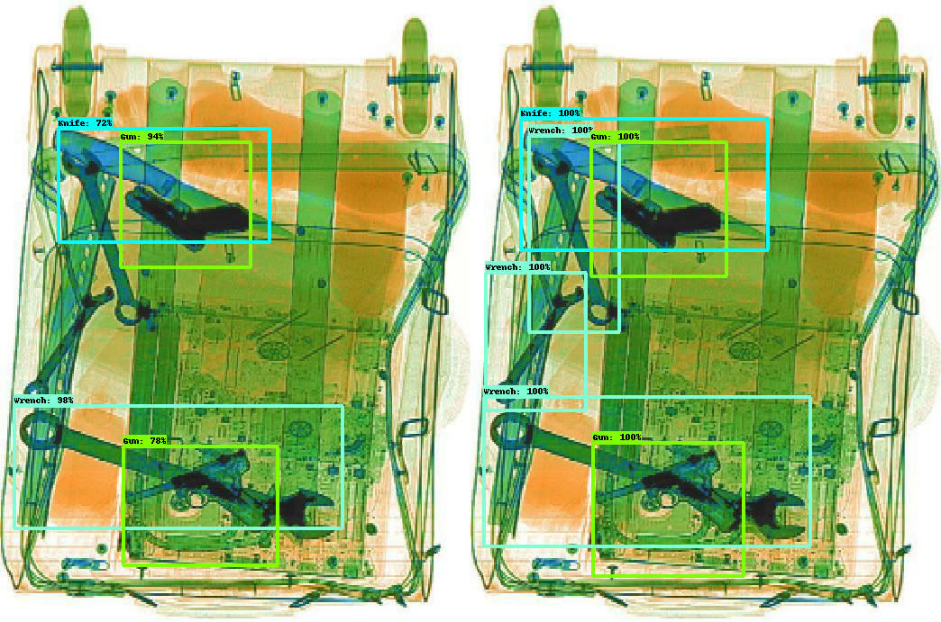
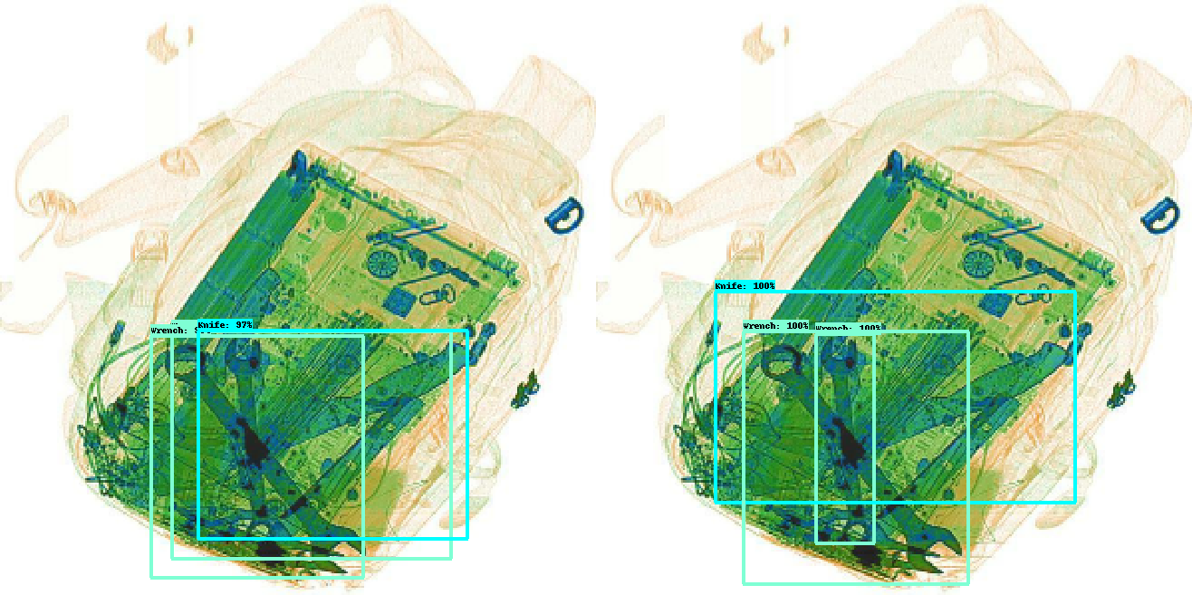
Prediction Real
Prediction Real

Slide 10

Schedule
Obtain dataset (Sixray dataset)
Pre-process image with location and class of the objects in image
Create pipeline on cloud for training model on cloud
Train Object detection model and see the results with subset of dataset
Train different Object detection model with subset of dataset
Evaluate each model in various metrics such as accuracy and recall score, time performance, etc.
Train model with full dataset (and may add new dataset into)
Repeat step 6 with our new models
Report, Poster, Video, Presentation

Slide 11
Future Work
(13 Mar – 19 Mar) Train different Object detection model with subset of dataset
(20 Mar – 21 Mar) Evaluate each model in various metrics such as accuracy and recall score, time performance, etc.
(22 Mar – 28 Mar) Train model with full dataset (and may add new dataset into)
(29 Mar – 31 Mar) Repeat step 6 with our new models
(1 Apr – later) Report, Poster, Video, Presentation

Slide 12
Potential Risk
Potential risk: the full dataset (with additional datasets) might be too complicated for our model.
Mitigation: we divide works for each group member to train different models.

Slide 13
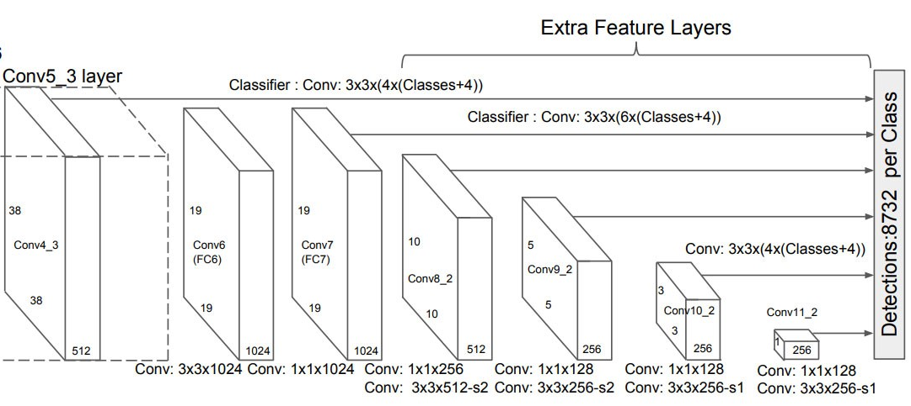
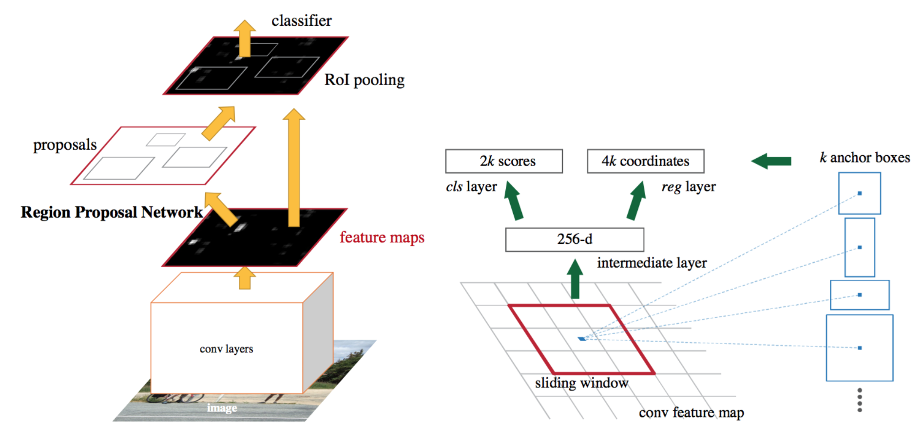
Models (Detection Network + Base Network)
Faster R-CNN + Inception v2
Faster R-CNN + Resnet50
Faster R-CNN + Resnet101
SSD + Inception v2
SSD + Resnet50
SSD + Mobilenet
Mask R-CNN + Inception v2
Mask R-CNN + Resnet50

